Slide 1
Foundations of Cryptography CBC, OFB, CTR
LiangFeng Zhang
zhanglf@shanghaitech.edu.cn

Slide 2
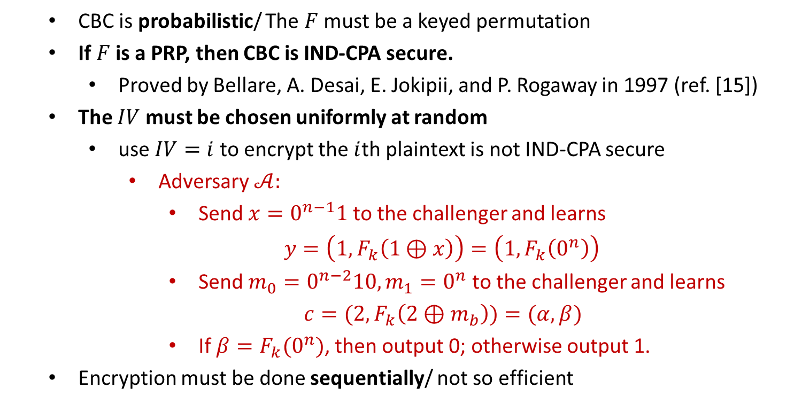
CBC
CBC is probabilistic/ The $F$ must be a keyed permutation
If $F$ is a PRP, then CBC is IND-CPA secure.
Proved by Bellare, A. Desai, E. Jokipii, and P. Rogaway in 1997 (ref. [15])
The $IV$ must be chosen uniformly at random
use $IV=i$ to encrypt the $i$th plaintext is not IND-CPA secure
Adversary $𝒜:$
Send $x=0^{n−1}1$ to the challenger and learns
$y=\left(1,F_{k}\left(1⊕x\right)\right)=\left(1,F_{k}\left(0^{n}\right)\right)$
Send $m_{0}=0^{n−2}10, m_{1}=0^{n}$ to the challenger and learns
$c=(2,F_{k}\left(2⊕m_{b}\right))=(α, β)$
If $β=F_{k}(0^{n})$, then output 0; otherwise output 1.
Encryption must be done sequentially/ not so efficient

Slide 3
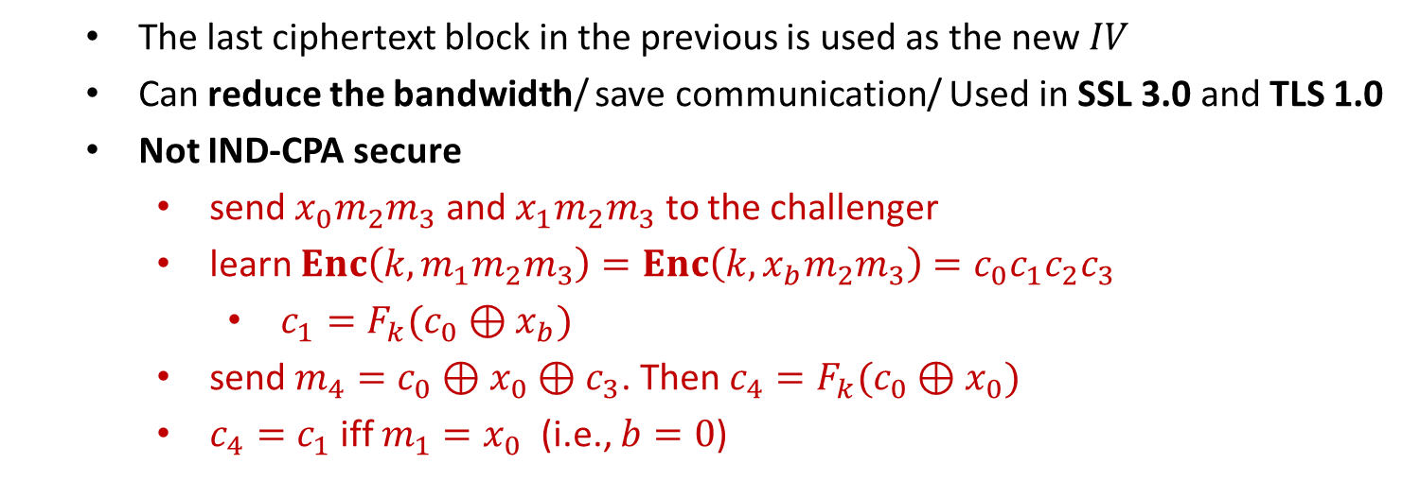
Chained CBC
The last ciphertext block in the previous is used as the new $IV$
Can reduce the bandwidth/ save communication/ Used in SSL 3.0 and TLS 1.0
Not IND-CPA secure
send $x_{0}m_{2}m_{3}$ and $x_{1}m_{2}m_{3}$ to the challenger
learn $Enc\left(k,m_{1}m_{2}m_{3}\right)=Enc\left(k,x_{b}m_{2}m_{3}\right)=c_{0}c_{1}c_{2}c_{3}$
$c_{1}=F_{k}(c_{0}⊕x_{b})$
send $m_{4}=c_{0}⊕x_{0}⊕c_{3}$. Then $c_{4}=F_{k}(c_{0}⊕x_{0})$
$c_{4}=c_{1}$ iff $m_{1}=x_{0}$ (i.e., $b=0$)

Slide 4


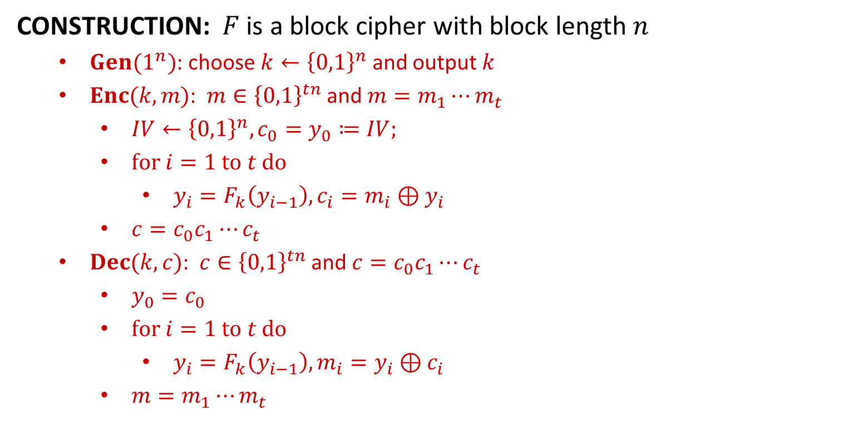











OFB
CONSTRUCTION: $F$ is a block cipher with block length $n$
$Gen(1^{n})$: choose $k←{\left\{0,1\right\}}^{n}$ and output $k$
$Enc(k,m)$: $m∈{\left\{0,1\right\}}^{tn}$ and $m=m_{1}⋯m_{t}$
$IV←{\left\{0,1\right\}}^{n}, {c_{0}=y}_{0}≔IV;$
$for i=1 to t do$
$y_{i}=F_{k}\left(y_{i−1}\right), c_{i}=m_{i}⊕y_{i}$
$c=c_{0}c_{1}⋯c_{t}$
$Dec(k,c)$: $c∈{\left\{0,1\right\}}^{tn}$ and $c=c_{0}c_{1}⋯c_{t}$
$y_{0}=c_{0}$
$for i=1 to t do$
$y_{i}=F_{k}\left(y_{i−1}\right), m_{i}=y_{i}⊕c_{i}$
$m=m_{1}⋯m_{t}$
$$IV$$
$$F_{k}$$
$$F_{k}$$
$$F_{k}$$
$$m_{1}$$
$$⨁$$
$$m_{2}$$
$$⨁$$
$$m_{3}$$
$$⨁$$
$$IV$$
$$c_{1}$$
$$c_{2}$$
$$c_{3}$$

Slide 5
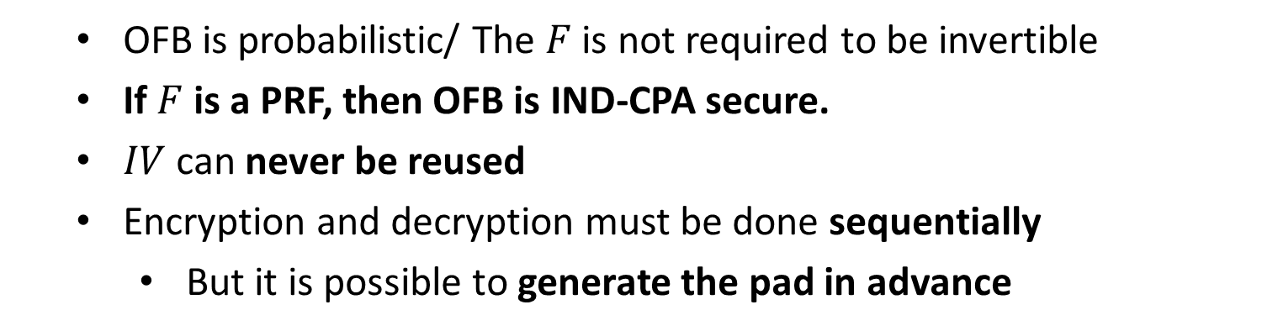
OFB
OFB is probabilistic/ The $F$ is not required to be invertible
If $F$ is a PRF, then OFB is IND-CPA secure.
$IV$ can never be reused
Encryption and decryption must be done sequentially
But it is possible to generate the pad in advance

Slide 6

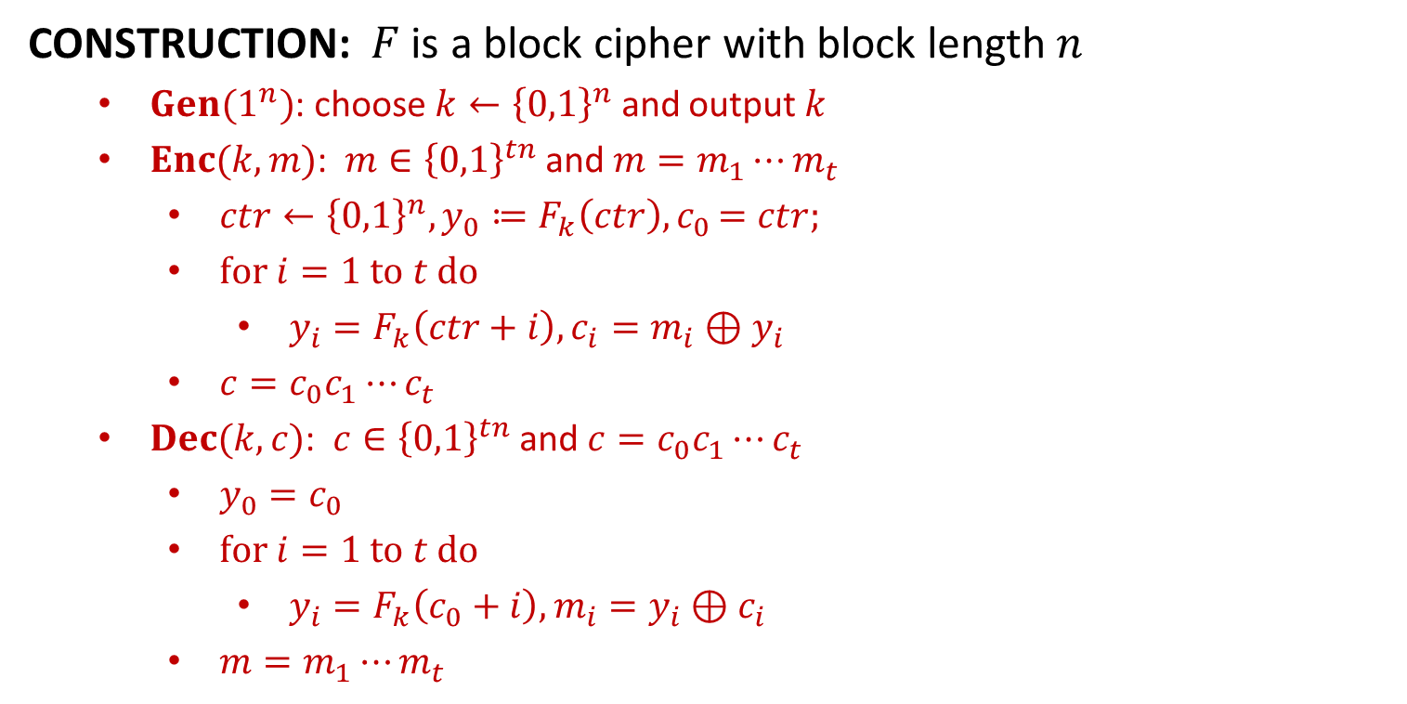




CTR
CONSTRUCTION: $F$ is a block cipher with block length $n$
$Gen(1^{n})$: choose $k←{\left\{0,1\right\}}^{n}$ and output $k$
$Enc(k,m)$: $m∈{\left\{0,1\right\}}^{tn}$ and $m=m_{1}⋯m_{t}$
$ctr←{\left\{0,1\right\}}^{n}, y_{0}≔F_{k}\left(ctr\right){, c}_{0}=ctr;$
$for i=1 to t do$
$y_{i}=F_{k}\left(ctr+i\right), c_{i}=m_{i}⊕y_{i}$
$c=c_{0}c_{1}⋯c_{t}$
$Dec(k,c)$: $c∈{\left\{0,1\right\}}^{tn}$ and $c=c_{0}c_{1}⋯c_{t}$
$y_{0}=c_{0}$
$for i=1 to t do$
$y_{i}=F_{k}\left(c_{0}+i\right), m_{i}=y_{i}⊕c_{i}$
$m=m_{1}⋯m_{t}$
$$ctr$$
$$ctr+1$$
$$ctr+2$$
$$ctr+3$$
$$F_{k}$$
$$F_{k}$$
$$F_{k}$$
$$m_{1}$$
$$⨁$$
$$m_{2}$$
$$⨁$$
$$m_{3}$$
$$⨁$$
$$ctr$$
$$c_{1}$$
$$c_{2}$$
$$c_{3}$$

Slide 7
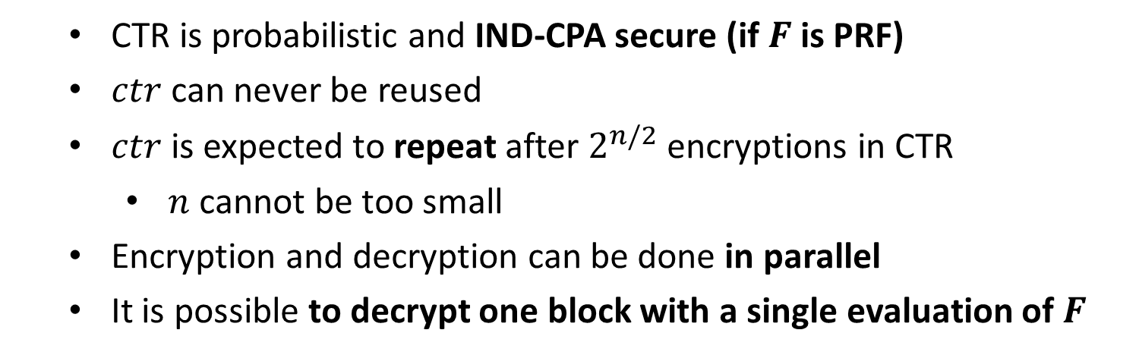
CTR
CTR is probabilistic and IND-CPA secure (if $F$ is PRF)
$ctr$ can never be reused
$ctr$ is expected to repeat after $2^{n/2}$ encryptions in CTR
$n$ cannot be too small
Encryption and decryption can be done in parallel
It is possible to decrypt one block with a single evaluation of $F$

Slide 8
CTR
THEOREM: If $F$ is a PRF, then CTR is IND-CPA secure.
$Π=(Gen,Enc,Dec)$: the CTR mode encryption
$Π′=(Gen′,Enc′,Dec′)$
only difference with $Π:$ $F_{k}$ is replaced with $f←Func_{n}$
For any PPT algorithm $𝒜$, we show that
$\left|\operatorname{Pr}\left[PrivK_{𝒜, Π}^{cpa}\left(n\right)=1\right] −\operatorname{Pr}\left[PrivK_{𝒜, Π^{′}}^{cpa}\left(n\right)=1\right] \right|≤negl(n)$
otherwise, the $𝒜$ can be used to attack PRF (next page)
We show that $\operatorname{Pr}\left[PrivK_{𝒜, Π^{′}}^{cpa}\left(n\right)=1\right] ≤\frac{1}{2}+\frac{2q^{2}}{2^{n}}$
$q\left(n\right):$ upper bound of the message length&number of queries
$ctr_{i}:$ the random counter for encrypting $x_{i}$, where $i∈[q]$
$t_{i}:$ the number of blocks in $x_{i}$
$I_{i}=\{ctr_{i}+1,…,ctr_{i}+t_{i}\}$

Slide 9
$$𝒪$$
$$𝒜$$
$${\left\{{ctr}_{i}+j\right\}}_{j=1}^{t_{i}}$$
$$x_{i}$$
$${ctr}_{i}←{\left\{0,1\right\}}^{n}$$
$$ctr_{i}$$
$$\{𝒪\left({ctr}_{i}+j\right)\}$$
$$\{𝒪\left({ctr}_{i}+j\right)⊕x_{ij}\}$$
$$m_{0},m_{1}$$
$${\left\{ctr+j\right\}}_{j=1}^{t}$$
$$ctr←{\left\{0,1\right\}}^{n}$$
$$\left|m_{0}\right|=|m_{1}|$$
$${\left\{𝒪\left(ctr+j\right)\right\}}_{j=1}^{t}$$
$$b←\{0,1\}$$
$$ctr$$
$$\{𝒪\left(ctr+j\right)⊕m_{bj}\}$$
$${\left\{{ctr}_{i}+j\right\}}_{j=1}^{t_{i}}$$
$$x_{i}$$
$${ctr}_{i}←{\left\{0,1\right\}}^{n}$$
$$ctr_{i}$$
$$\{𝒪\left({ctr}_{i}+j\right)\}$$
$$\{𝒪\left({ctr}_{i}+j\right)⊕x_{ij}\}$$
$$b^{′}=b:output 1$$
$$b^{′}≠b:output 0$$
$$b′$$
$$𝒟$$

Slide 10
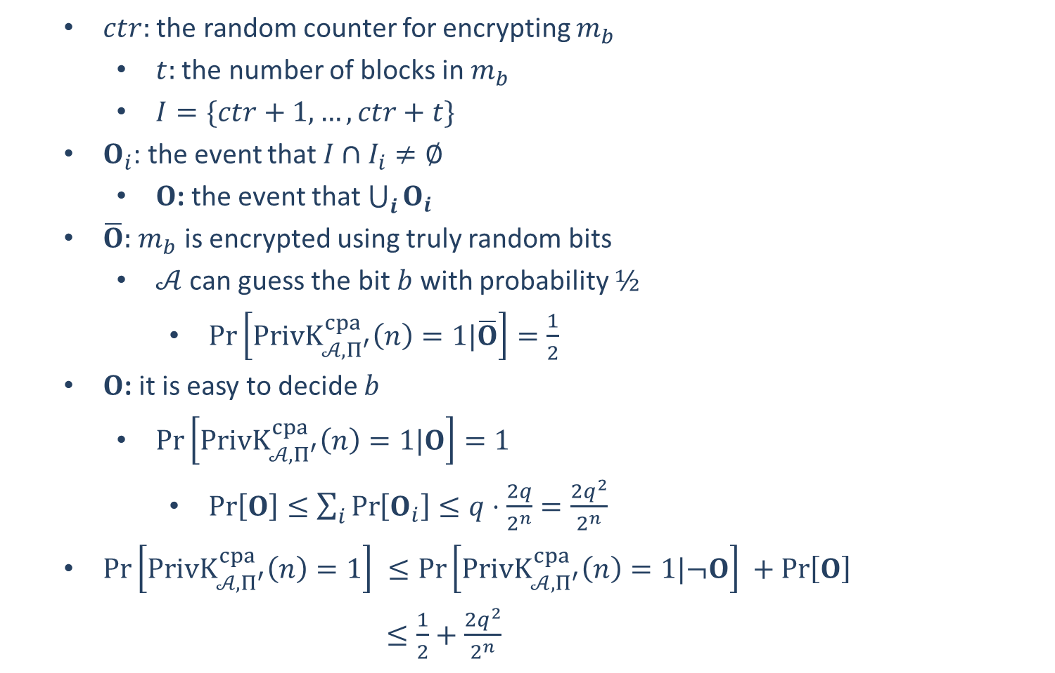
$ctr:$ the random counter for encrypting $m_{b}$
$t:$ the number of blocks in $m_{b}$
$I=\{ctr+1,…,ctr+t\}$
$O_{i}$: the event that $I∩I_{i}≠∅$
$O$: the event that $\bigcup_{i}{O_{i}}$
$\overline{O}:$ $m_{b}$ is encrypted using truly random bits
$𝒜$ can guess the bit $b$ with probability $½$
$\operatorname{Pr}\left[PrivK_{𝒜, Π^{′}}^{cpa}\left(n\right)=1|\overline{O}\right]=\frac{1}{2}$
$O$: it is easy to decide $b$
$\operatorname{Pr}\left[PrivK_{𝒜, Π^{′}}^{cpa}\left(n\right)=1|O\right]=1$
$\operatorname{Pr}\left[O\right]≤\sum_{i}{\operatorname{Pr}\left[O_{i}\right]≤q⋅\frac{2q}{2^{n}}=\frac{2q^{2}}{2^{n}}}$
$\operatorname{Pr}\left[PrivK_{𝒜, Π^{′}}^{cpa}\left(n\right)=1\right] ≤\operatorname{Pr}\left[PrivK_{𝒜, Π^{′}}^{cpa}\left(n\right)=1|¬O\right] +\operatorname{Pr}\left[O\right]$
$≤\frac{1}{2}+\frac{2q^{2}}{2^{n}}$

